Slide 1
Assignment – 6 (IAM, Commands)
S3, EBS & IAM Practical
Create S3 bucket
Do hands-on on S3 properties
  Bucket Versioning
  Server access logging
  AWS CloudTrail data events
  Static website hosting (including permission) [ref. - https://www.w3schools.com/html/]
Create Lifecycle rules
Do EBS practical mentioned in doc “Volume-extend-aws.doc”.
  Create new EBS volume
  Assign it to server
  Format volume
  Mount temporary and permanent both.
  Extend both data and root volume
Create IAM group, users, policy, AWSCLI users, roles and test the access.
Create AWSCLI user and configure awscli and test all commands mentioned in document.

Slide 2
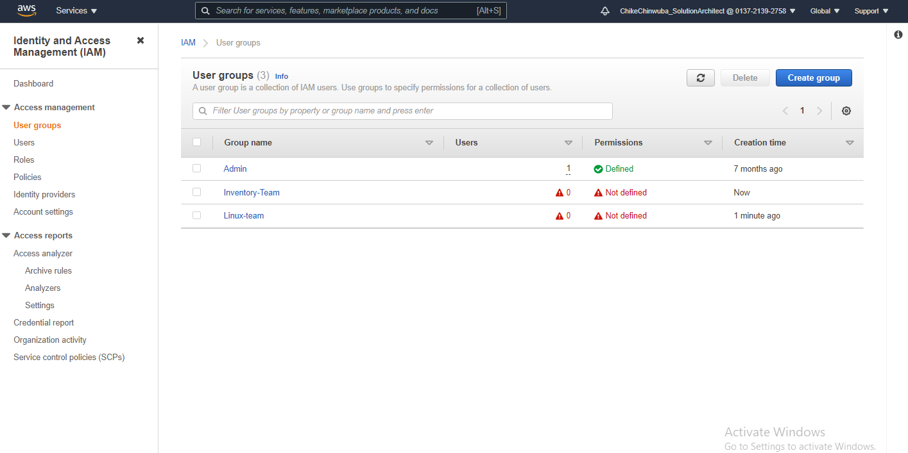
User -Groups

Slide 3
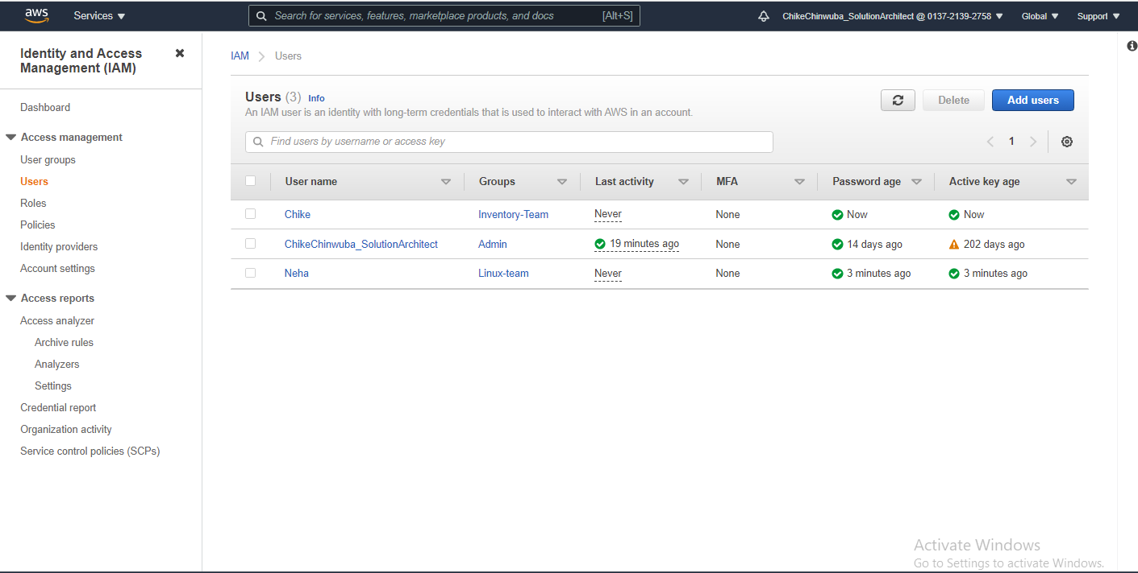
Usernames

Slide 4
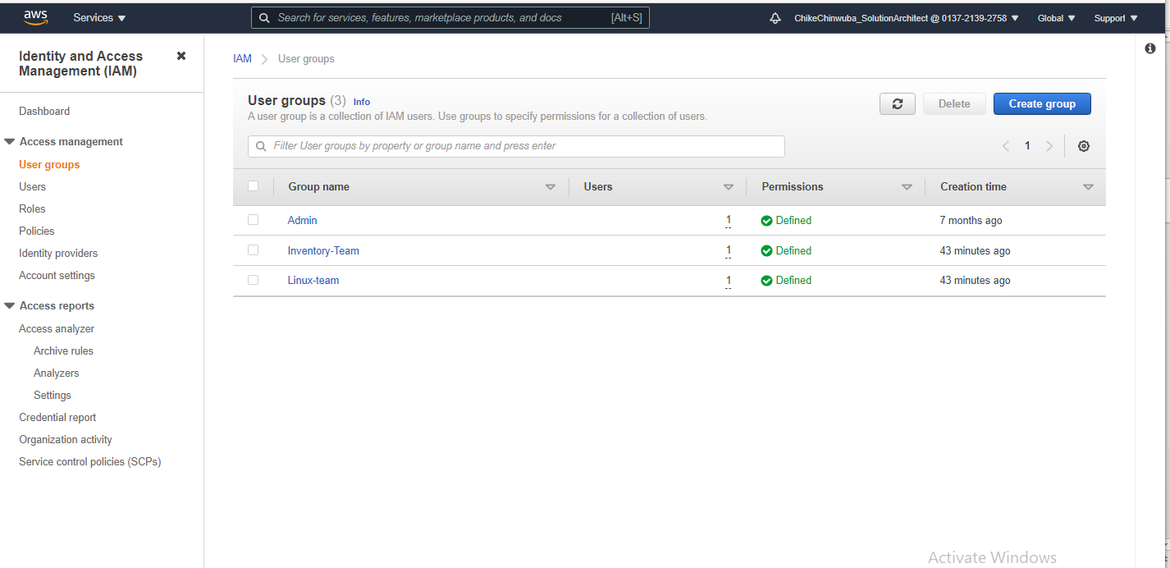
User groups with permissions

Slide 5
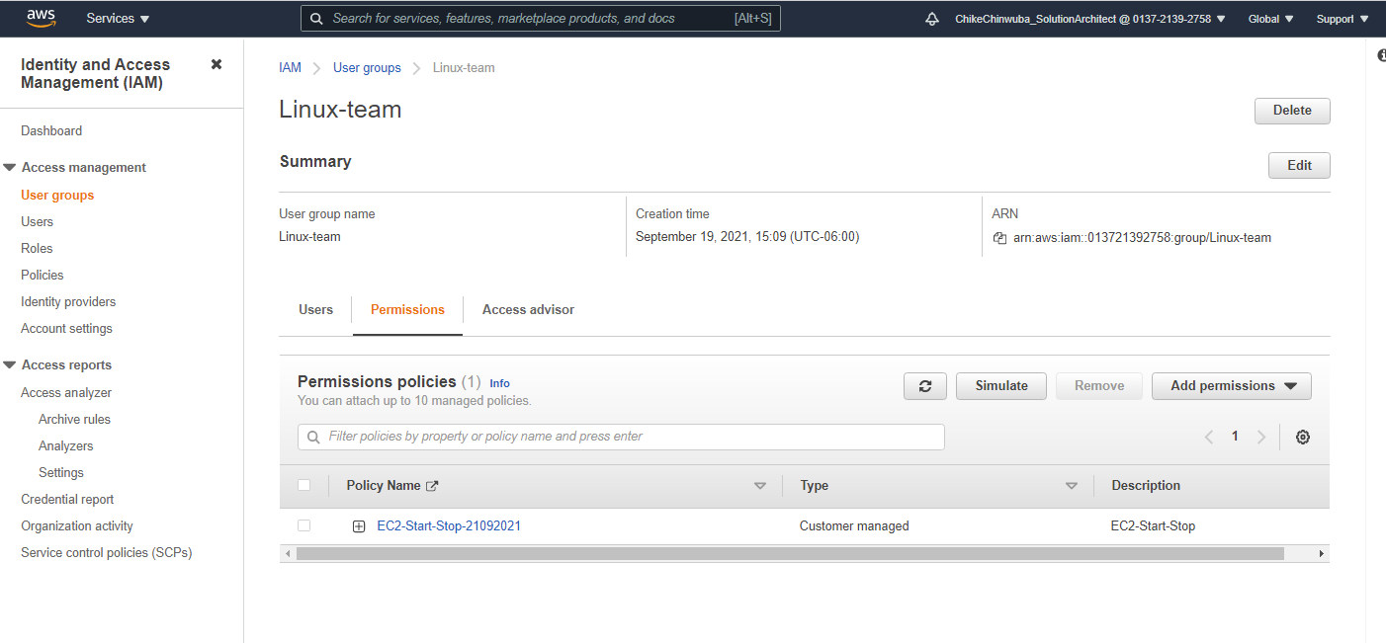
Linux-team – EC2 –Start-Stop policy

Slide 6
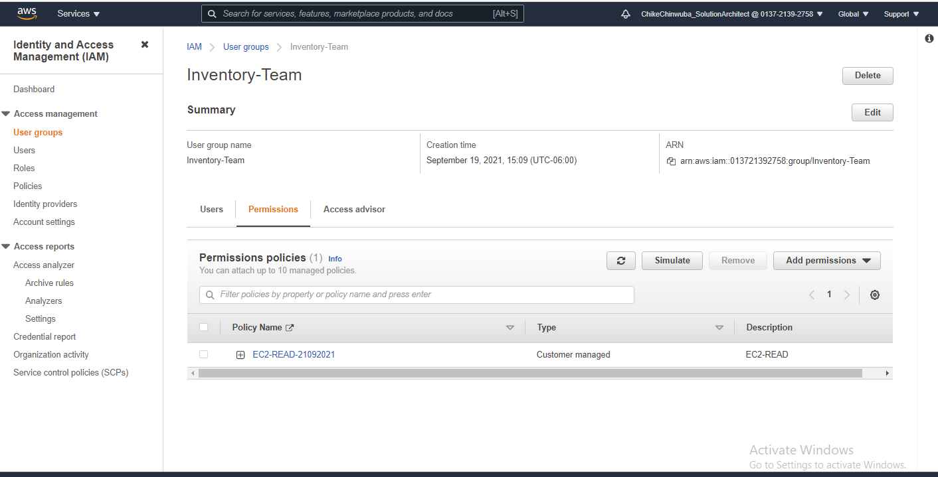
Inventory-team – EC2 –ReadOnly

Slide 7
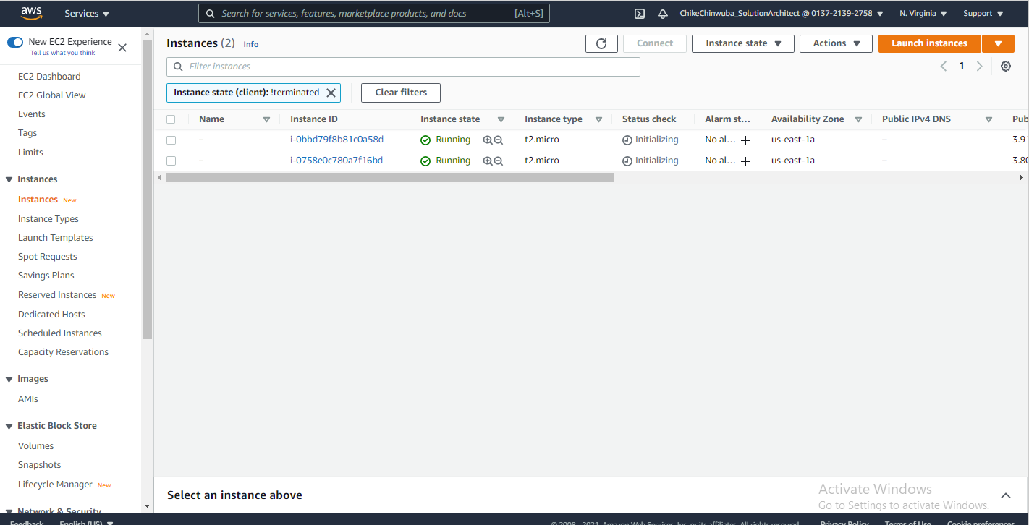
EC2 INSTANCES RUNNING

Slide 8
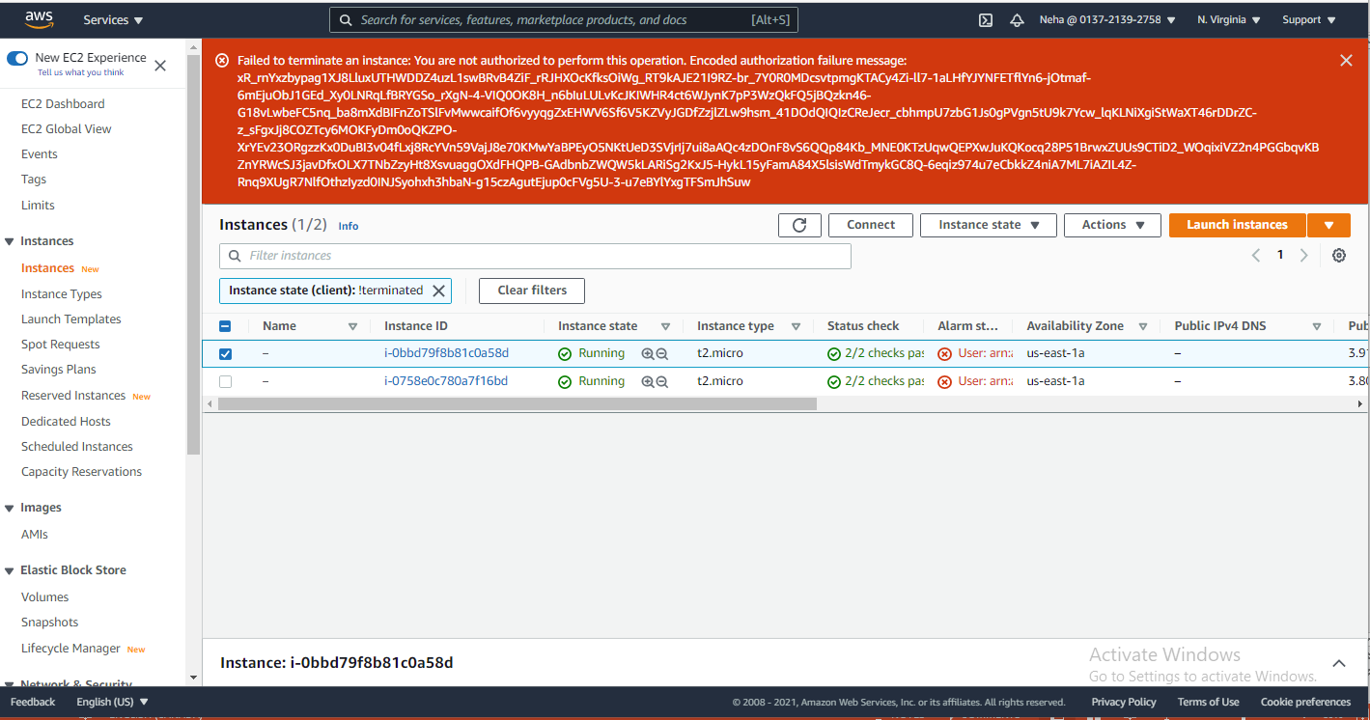
EC2 INSTANCES CANNOT TERMINATE - Neha

Slide 9
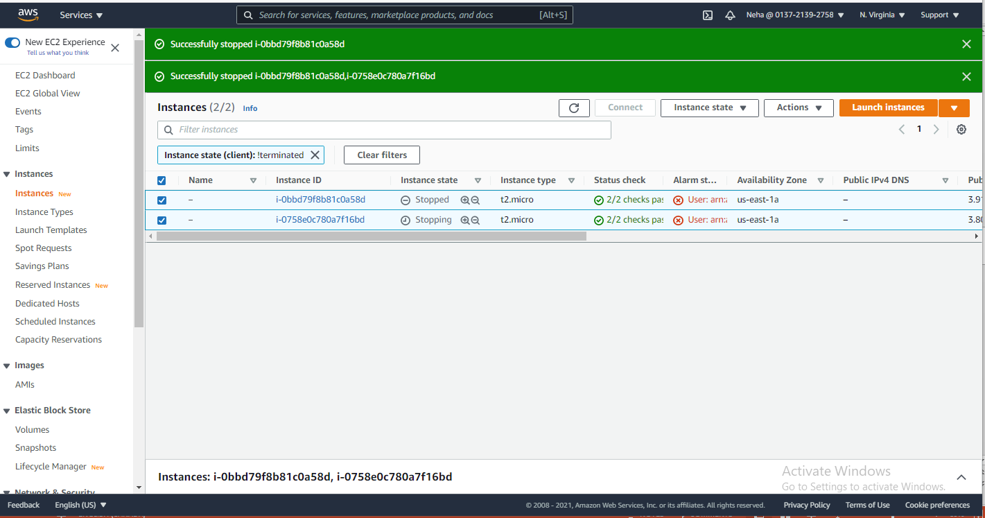
EC2 INSTANCES STOPPED - Neha

Slide 10
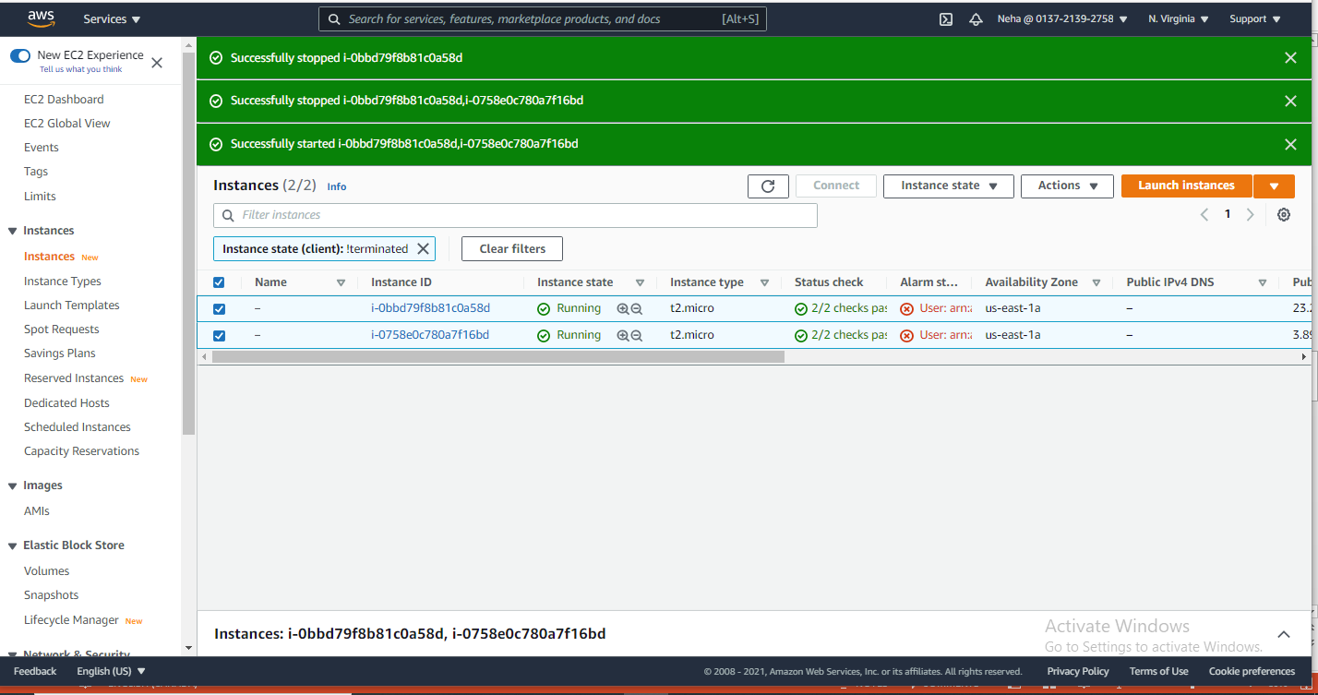
EC2 INSTANCES STARTED - Neha

Slide 11
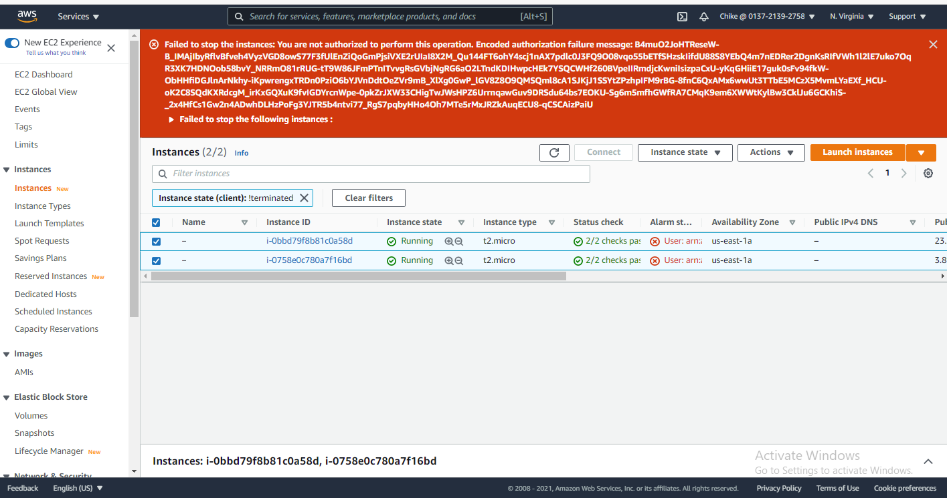
EC2 INSTANCES CANNOT BE STOPPED - Chike

Slide 12
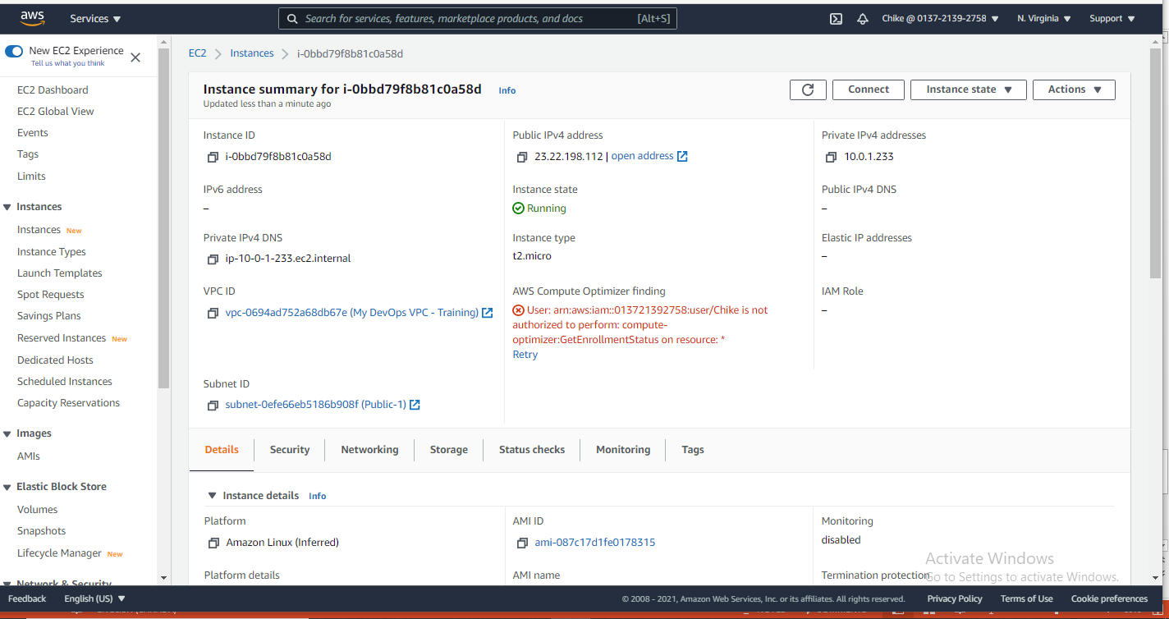
EC2 INSTANCES CAN BE VIEWED - Chike

Slide 13
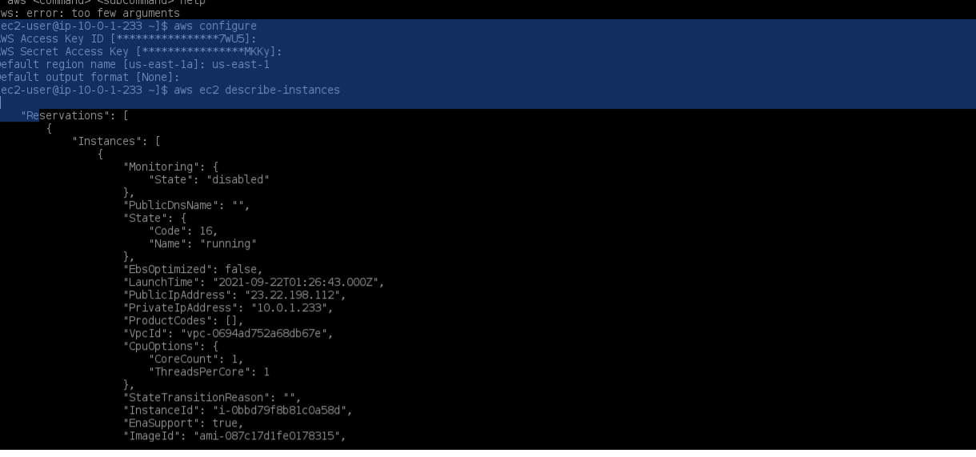
Command Line – Describe Instances –Text Format

Slide 14
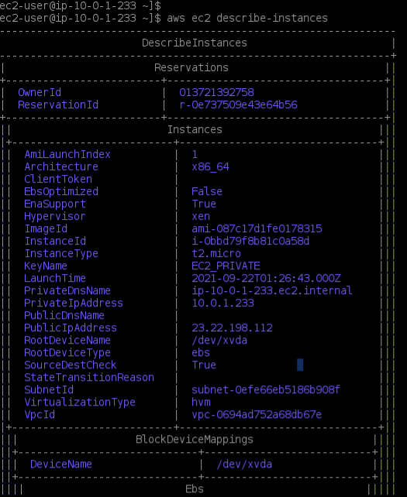
Command Line – Describe Instances Tabular Format

Slide 15
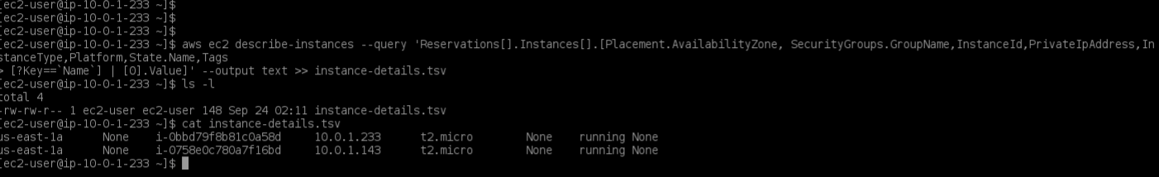
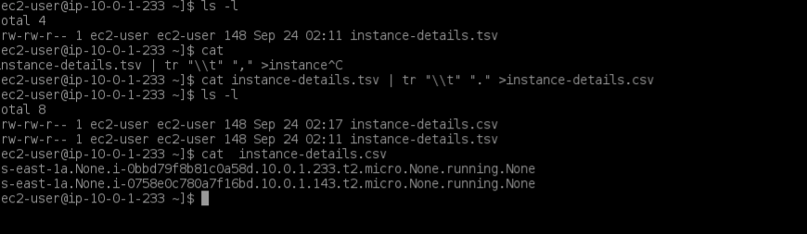
Output to tsv files
Convert to csv files

Slide 16
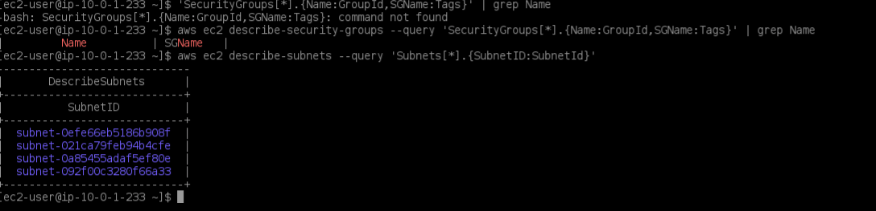
Query to list Subnets

Slide 17
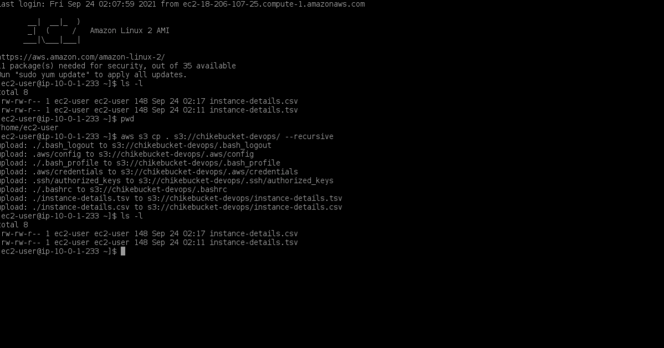
Cp command to upload to s3 buckets

Slide 18
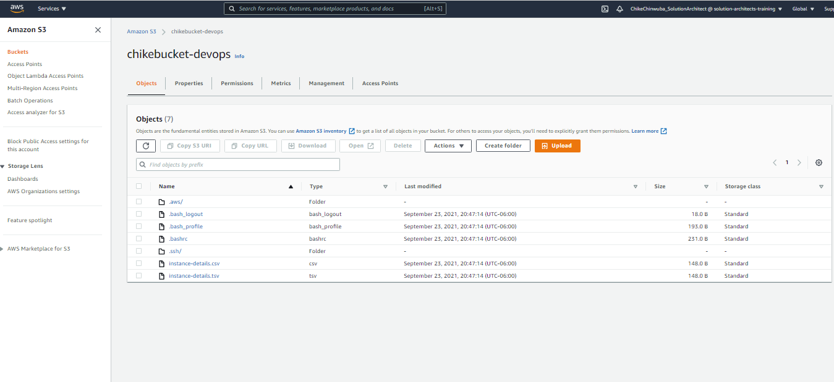
Console GUI display of uploaded files to s3 buckets

Slide 19
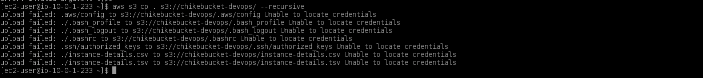
Cp command failed after removing credentials

Slide 20
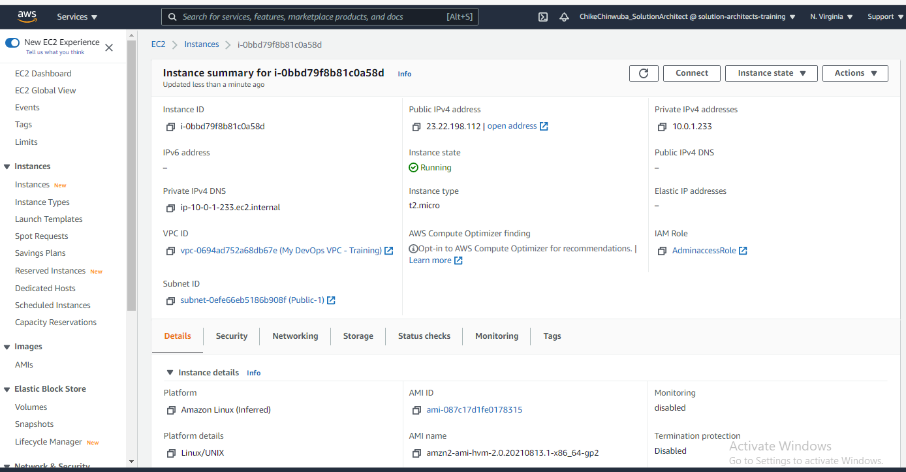
Created an IAM role for EC2 Instances

Slide 21
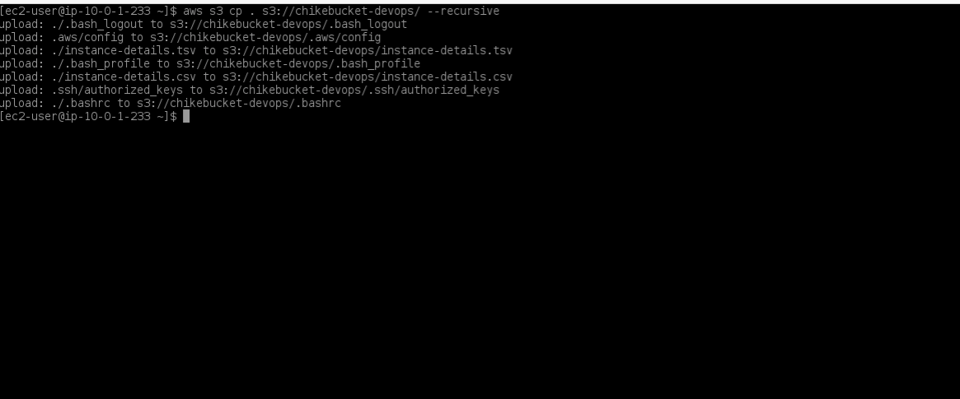
Cp command worked after creating IAM role

